Slide 1
An Information Retrieval Perspective of Filter Selection for Adaptive User Interfaces
Authors: Reda Bouadjenek, Yihao Du and Scott Sanner
Date: 21/02/2018

Slide 2
Agenda
5 parts
Introduction
Filter Optimization
Optimized metrics
Filter Optimization algorithms:
Dichotomy and Greedy
MILP approach
Evaluation
Conclusion and Future Work
Demo:
Viz-TSF: A Visual Twitter Search Tool based on Query-driven Filter Optimization

Slide 3
Introduction

Slide 4
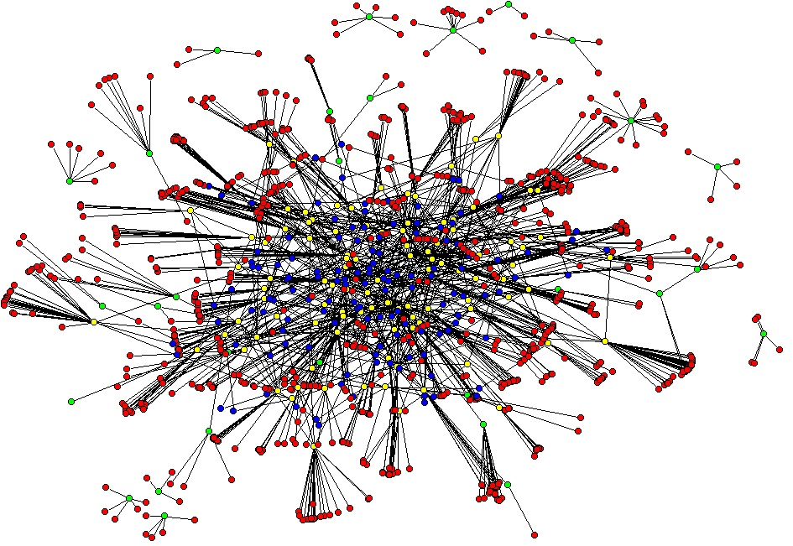
Introduction
High information systems are usually represented and visualized with large-scale graphs in which:
Elements are described with metadata, e.g., text, timestamp, location, IP address, etc.
Elements may be connected to model interactions, e.g., messages exchanged, transactions, etc.
Elements may be relevant relevant for given task, e.g., an email being a spam, and account being compromised, etc.
The volume of information prevents the simultaneous presentation of all information.
Explore Adaptive User Interfaces (AUIs)
Social media monitoring
Network security graph

Slide 5
Why AUIs?
A good approach for information-filtering in order to provide localized and relevant context for each event.
Allow the user to effectively investigate the event.
Investigate the cause and implications of the event.
Identify critical properties of the elements involved in the event.
Initiate appropriate corrective actions in a timely manner.
We argue that this information-filtering task is central to a variety of AUIs.

Slide 6
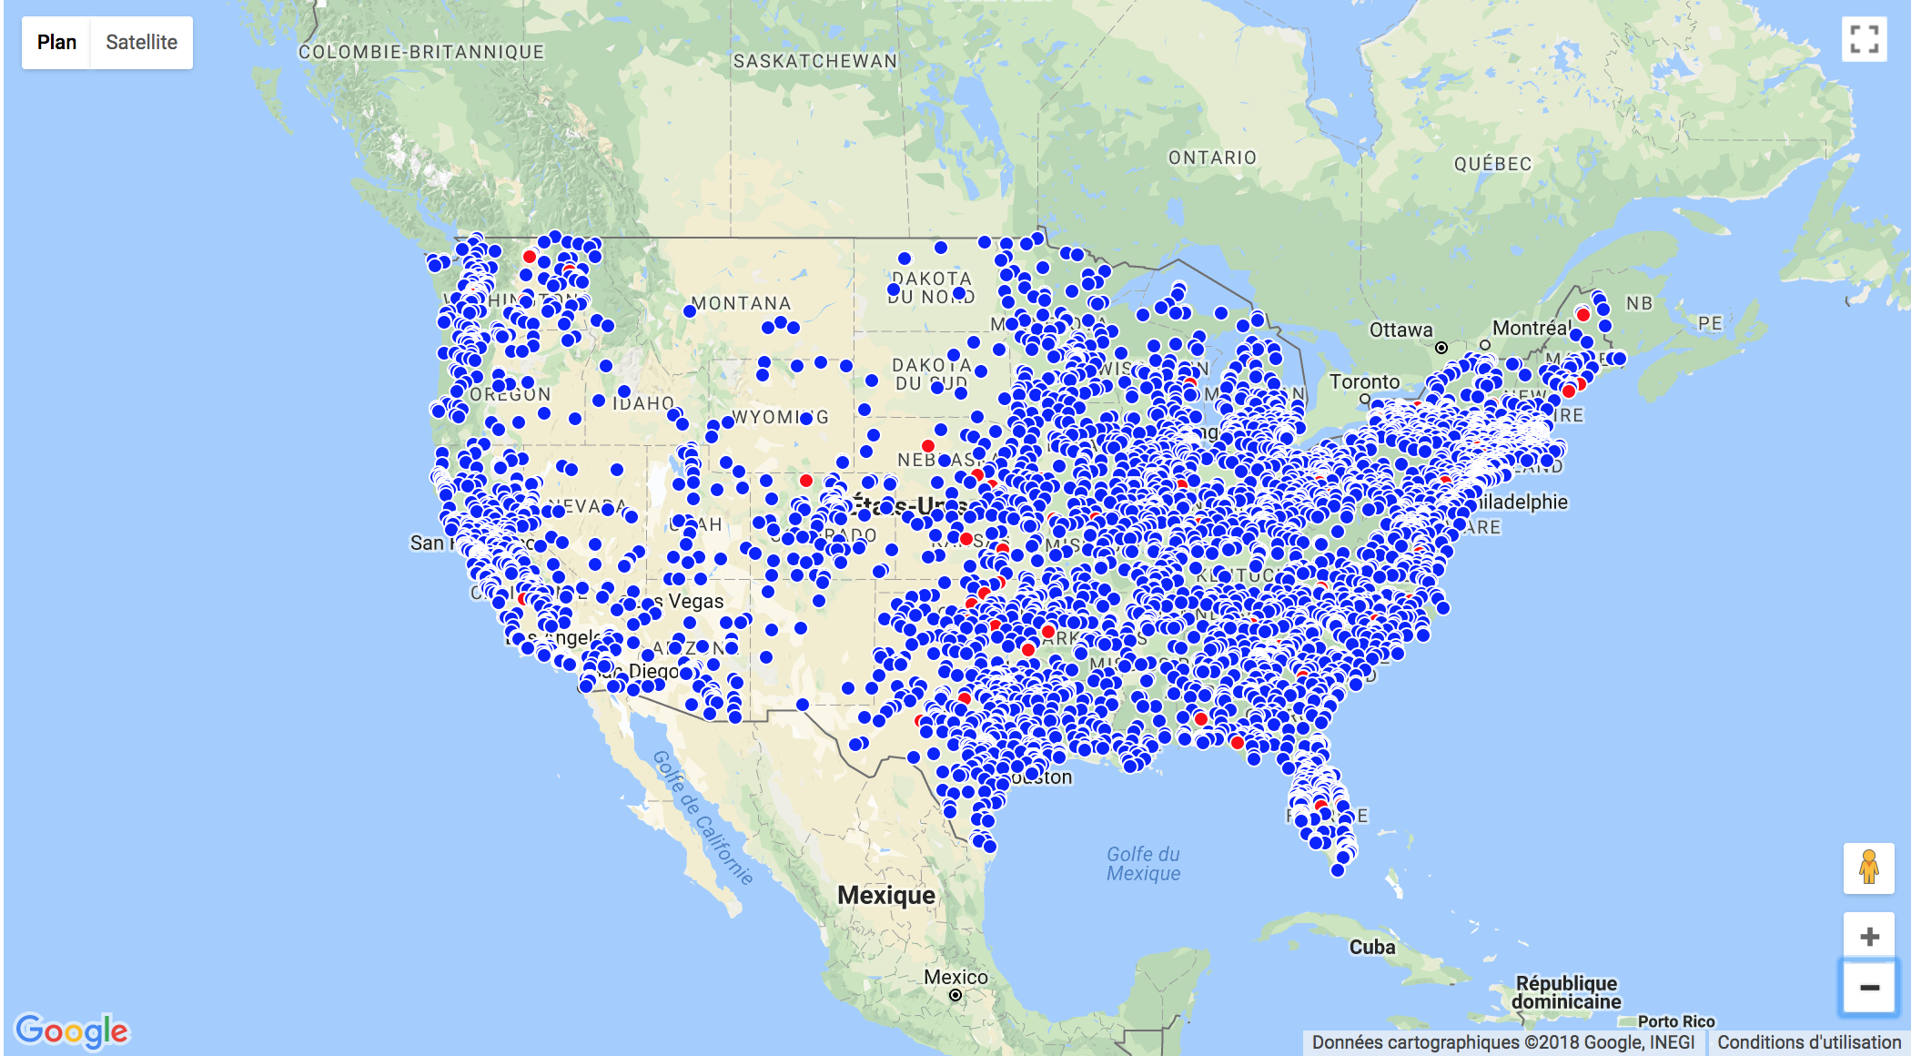
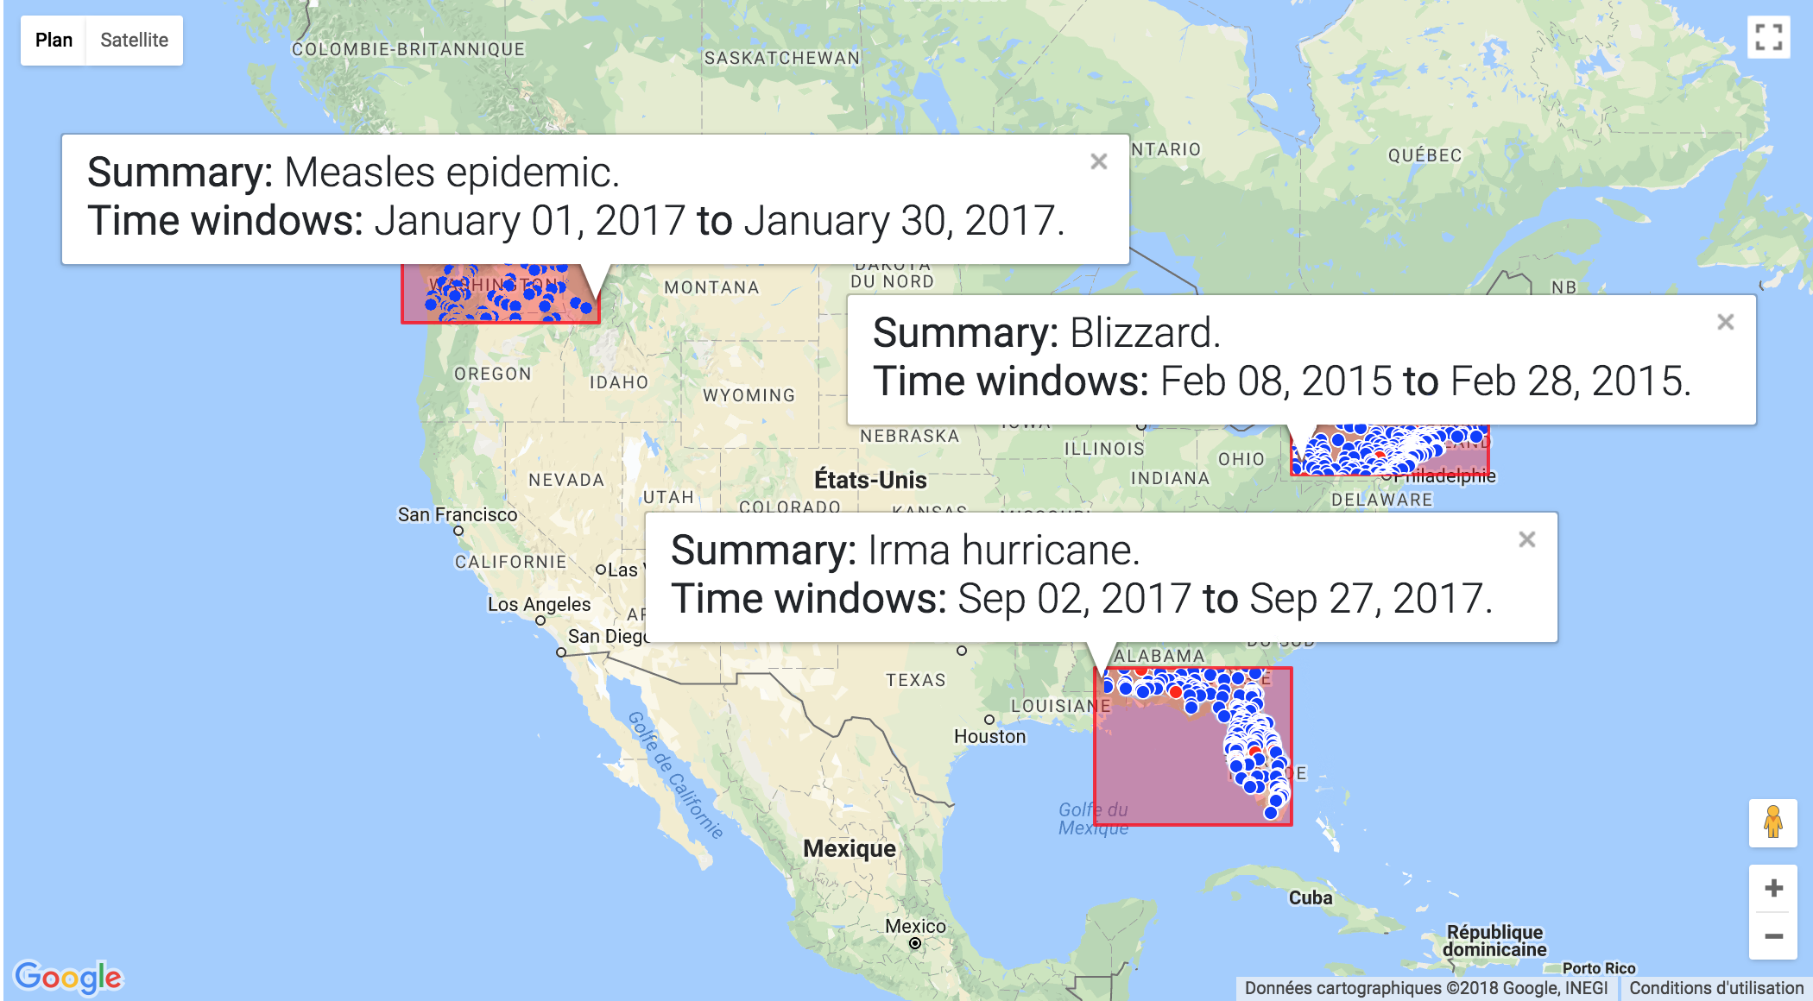
Example: Information-Filtering
An unfiltered user interface with geo-located tweets appearing more red according to their probability of classification as natural disaster.
A filtered version of the interface showing three filtered subsets of data identified to have high coverage of relevant content.

Slide 7
Problem
Given an information visualization system, how to select the best filter settings to have high coverage of relevant content?
We address this problem as an optimization problem.
Given that a filter is built by combining three sub-filters:
Time: expresses the time window of a retrieved set.
Keyword: expresses a set of keyword to include/exclude from a retrieved set.
Location: expresses a bounding box of a retrieved set.

Slide 8
Filter Optimization
Optimized metrics
Filter Optimization algorithms:
Dichotomy and Greedy
MILP approach

Slide 9
Optimized metrics for filter evaluation 1/2
A filter can be evaluated using conventional IR metrics, e.g., Precision, Recall, F1-Score, etc.
Optimizing any metric will lead to get optimal filters.
Problem: In practice, no real relevance label is provided.
Relevance probability scores can be computed, e.g., probability of and email being a spam, or a tweet being topical.
We define new expected metrics!

Slide 10
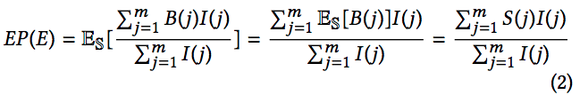
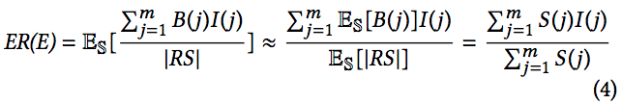
Optimized metrics for filter evaluation 2/2
Optimize new (approximations of) expected metrics, i.e., Expected-(Precision, Recall, F1-Score).
Expected-P and approximated Expected-R (using 1st order approximation):
Approximated EF1 is based on EP and ER.
Scatter plot showing EF1-Score vs. F1-Score.

Slide 11
Optimization algorithms
Three algorithms are described in the paper.
Top-down algorithms.
A greedy dichotomy-based algorithm.
A greedy algorithm.
A MILP-based solution used for benchmarking.
Other algorithms?
Bottom-up algorithms.
Greedy algorithm.

Slide 12
Dichotomy algorithm: Time filter
Top-down approach based on a binary space partitioning.
Search for upper bound, then for lower bound.
Fixing min
Upper bound
Time
e₈
e₁
Ef1`
e₅
e₇
e₃
e₄
e₂
Ef1

Slide 13
Dichotomy algorithm: Time filter
Top-down approach based on a binary space partitioning.
Search for upper bound, then for lower bound.
Fixing max
Time
e₈
e₁
e₅
e₇
e₃
e₄
e₂
Ef1`
Ef1
Ef1
Lower bound

Slide 14
Dichotomy algorithm: Location filter
The same algorithm can be used to build the location filter.
Start with x-axis then y-axis.

Slide 15
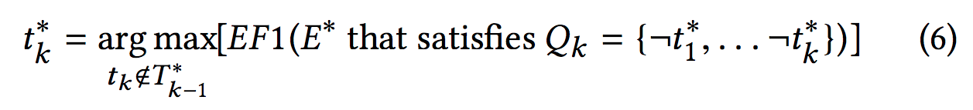
Greedy algorithm: Keyword filter
Select terms to build a negation query, i.e., exclude elements containing these terms.
Algorithm:
Select top 100 terms ranked using mutual information.
Building T∗_{k} in a greedy manner by choosing the next optimal term t∗_{k} given the previous set of optimal term selections T∗_{k-1} = {t∗₁ , . . . ,t∗_{k−1}} (assuming T∗₀ = ∅) using the following selection criterion:

Slide 16
How to build a multi-filter query?
The algorithm greedily selects at each iteration the best sub-filter.
T
T
T
T
L
T
T
L
T
T
T
T
L
End
E
L
K
L
L
K
L
L
T
L
L
K
K
K
K
K
K
L
K
K
K
Sequence={T₁,K₂,L₃,T₄,K₅,L₆,K₇,T₈,L₉,T₁₀} -> filter={T₁₀} and {L₉} and {¬K₂, ¬K₅, ¬K₇}

Slide 17
Multiple Filter Selection Wrapper
One filter is not enough!
It narrows the user in exploring a single filter.
Algorithm:
After the first filter is produced, all selected elements have their scores zeroed out.
The filtering algorithm is then run again, where it will inherently focus on a different content set.
Repeat until the desired number of filters is reached.

Slide 18
Evaluation

Slide 19
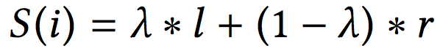
Experimental setup
Evaluation performed on three datasets
Enron: Investigating malware emails.
Twitter: Investigating natural disaster tweets.
Reddit: Investigating illegal transactions.
Evaluation methodology
We assume that we have a third party application-specific tool that predicts the probability score that each element is relevant.
Randomly select n elements from the global dataset.
Randomly select m elements from n an assume are the relevant elements.
The relevance score is computed as:
We select 10 times independently random elements as being relevant
We report the average results using real F1-Score.

Slide 20
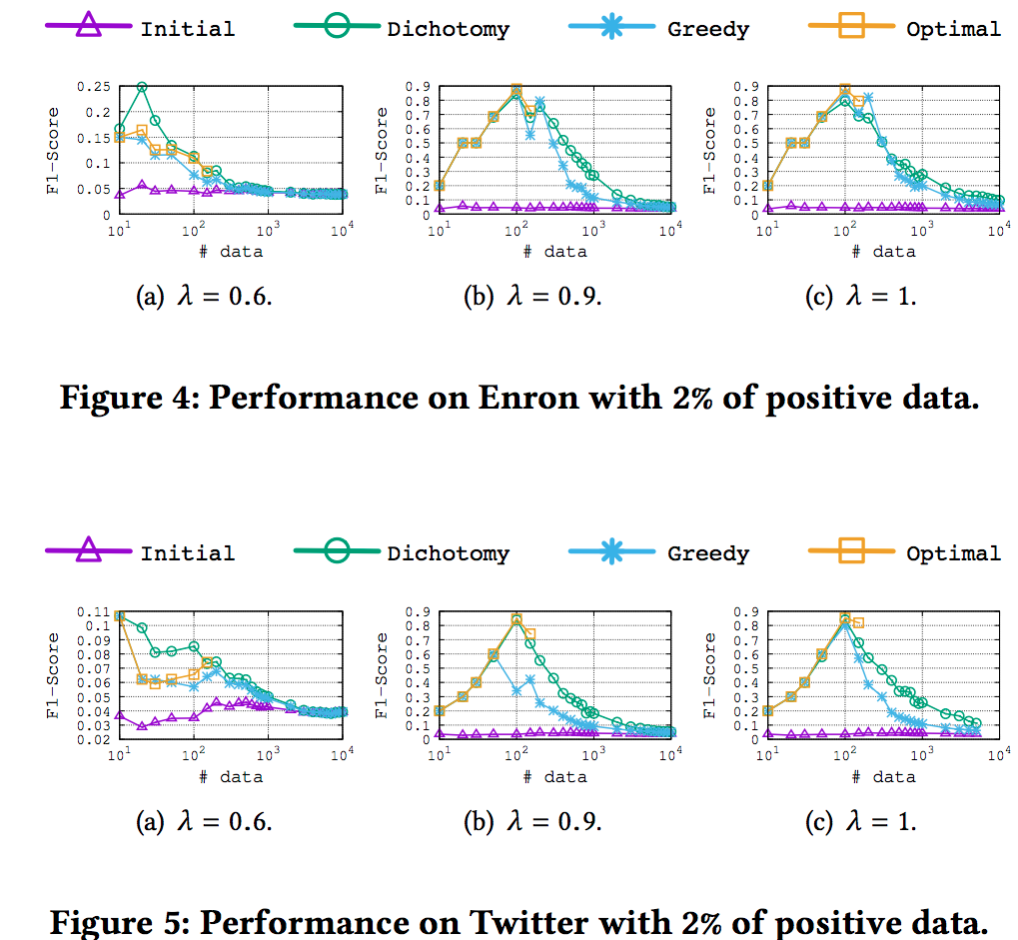
Performance analysis: F1-Score vs. #data
Curves of the same algorithm with the same parameters have the same shape.
Algorithms are consistent across datasets.
It becomes harder to optimize F1 as the size of the data grows
It is harder to separate signal from noise with existing filters.
The dichotomy and greedy algorithms are a good approximation of the optimal solution.
The dichotomy method doing better for some cases

Slide 21
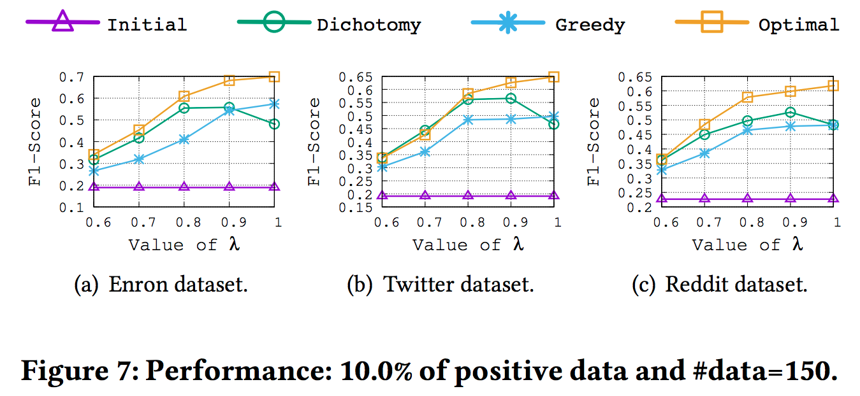
Performance analysis: F1-Score vs. λ
Problem becomes easier (high F1-Score value) as λ increases because.
EF1 becomes closer to real F1-Score,
Optimizing the real F1-Score.
Dichotomy algorithm does better for high noise
It doesn’t overfit to singletons as easily as Greedy; in contrast Greedy does overfit which is better for low noise since it can optimize small details that are actually valid.
For high noise, the Dichotomy algorithm is a good approximation of the optimal method. (error in the paper)

Slide 22
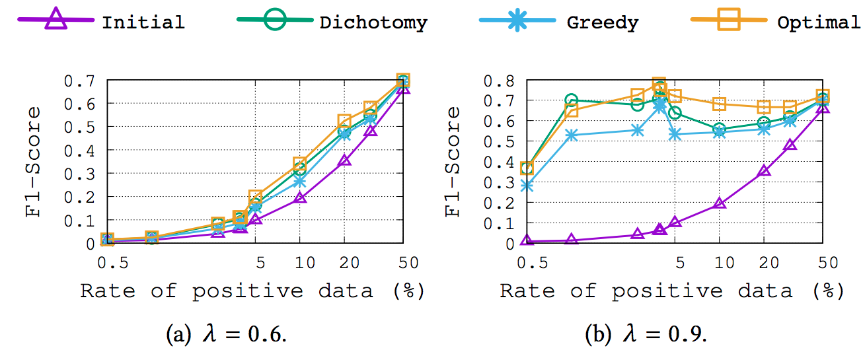
Performance analysis: F1-Score vs. rate of positive data
Problem becomes easier as the number of positive examples increases as well as the value of λ increases (i.e., noise decreases).
A low value of λ tends to lead the algorithms to select all content (close to Initial unfiltered set) due to the level of noise, while
A high value of λ tends to lead the algorithms to select the actual positive examples and thus maximize F1-Score.

Slide 23
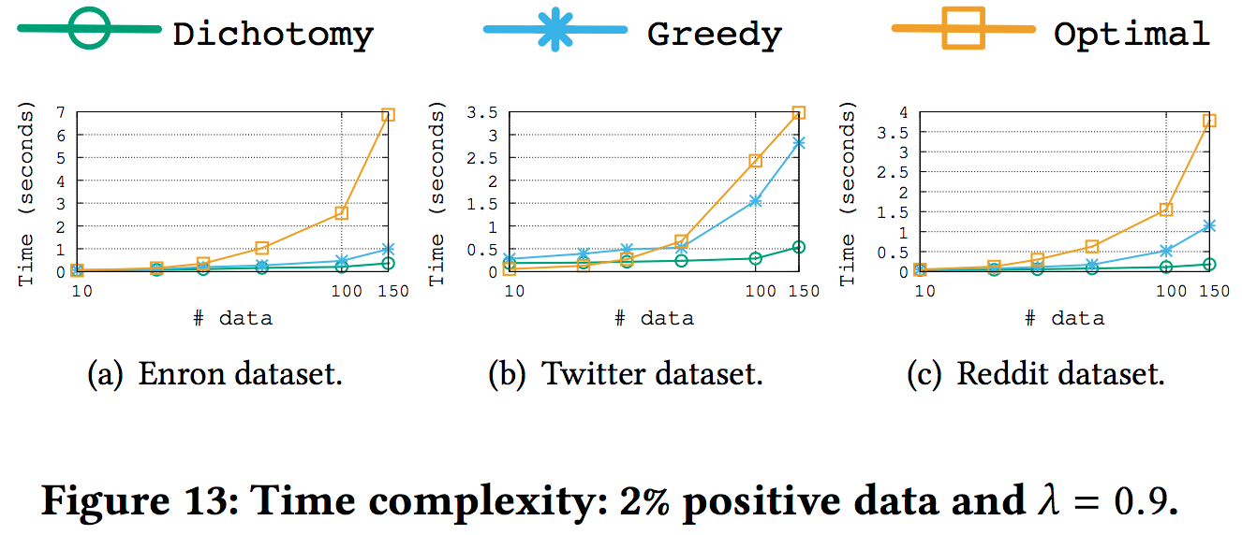
Computational time complexity analysis: Time vs. #data
Problem becomes harder as the size of the data increases
Enron has highest time complexity followed by the Reddit dataset, and then the Twitter dataset.
More terms (parameters) to optimize in Enron.
Dichotomy algorithm has a lower time complexity than the greedy algorithm.

Slide 24
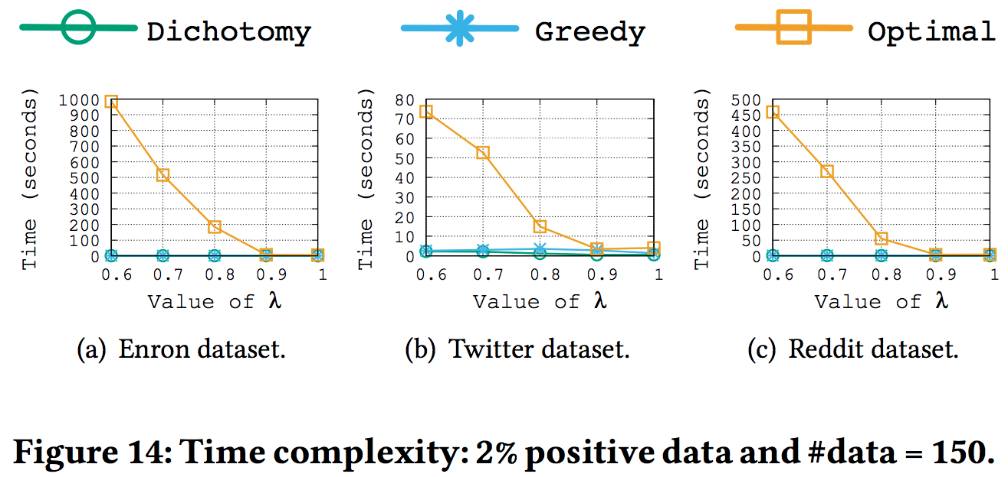
Computational time complexity analysis: Time vs. λ
For λ = 0.6, the optimization algorithm has a very high time complexity.
Optimal solution is clearly unscalable.
The time complexity reduces as the value of λ increases.
All algorithms need to make a large number of iterations to find the best solution with high noise (low λ).

Slide 25
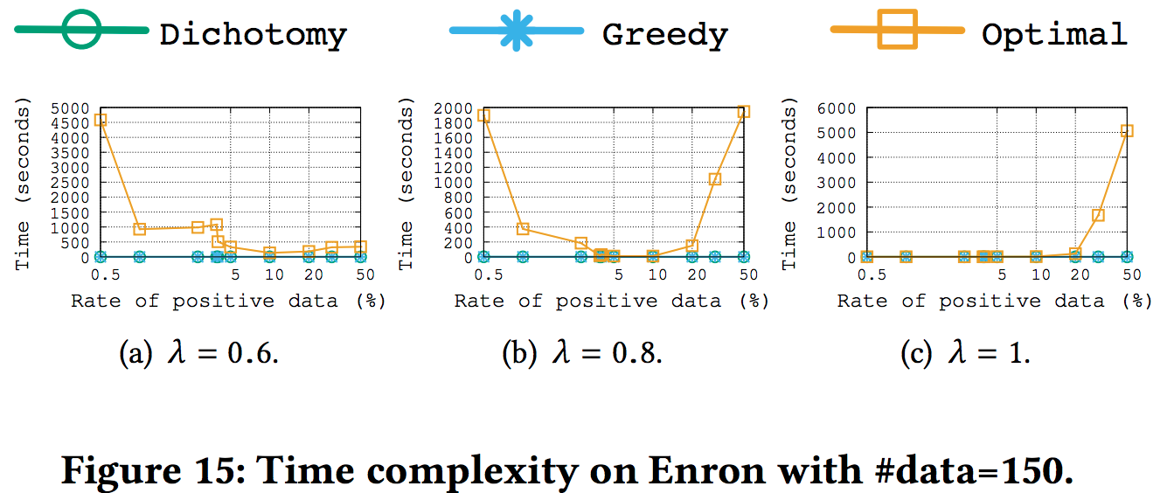
Computational time complexity analysis: Time vs. rate of positive data
High noise (low λ) makes a hard problem for the optimization algorithm, but increasing the rate of positive examples causes it to select everything (making the problem easier).
Low noise (high λ), only a few elements are selected for a low rate of positive data, but the optimization algorithm has to work hard to select the right 50% for high rate of positive data.
For moderate noise, we observe both effects.

Slide 26
Conclusion and Future work

Slide 27
Conclusion
A novel IR perspective of filtering for Adaptive User Interfaces.
New filter search algorithms for expected F1-Score based on two different Greedy strategies.
A method for optimization of expected F1-score using a MILP approach for purposes of benchmarking.
A thorough evaluation on three different datasets.
Approximated EF1-Score is a good approximation of real F1-Score.
Greedy algorithms are good approximation on the optimal solution.
Weak points in the paper.
Focus on the evaluation of the first filter.
No user oriented evaluation of how useful is this filtering approach.

Slide 28
Future work
Consideration of the role of explicit/implicit feedback methods to create a tighter and more responsive user interaction loop.
Perform a user study to assess how this filtering approach is useful and meaningful in helping users to carry their investigation tasks. (ongoing)
Integrate the filtering strategy to Dusan’s tool.
Connecting Kasra’s work on API query learning with our current Visual Twitter Search Tool (Viz-TSF).

Slide 29
Demo
Viz-TSF: A Visual Twitter Search Tool based on Query-driven Filter Optimization
http://130.220.208.198:8080/AUI4IRSearch/

Slide 30
<?>Questions</?>

